Slide 1
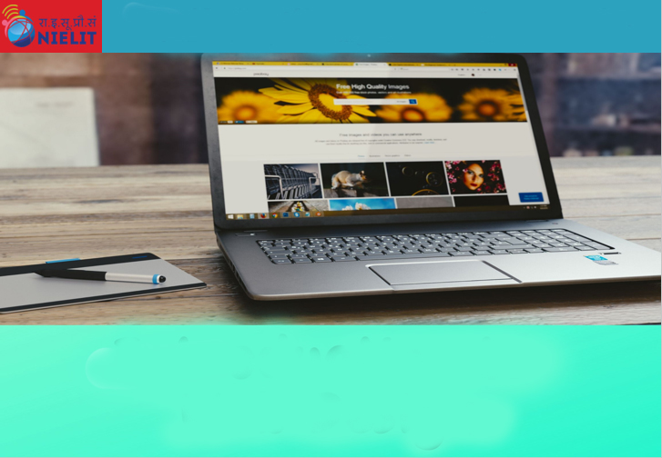
File and Printer sharing in Windows NT Environment
NATIONAL INSTITUTE OF ELECTRONICS AND INFORMATION TECHNOLOGY
Birla Farms, Bada Phull, Ropar
NIELIT ‘O’-Level
IT Tools and Network basics

Slide 2
Index
Introduction
Mobile Social Network
Mobile apps for social networking
Use of apps and models
Types of mobile apps
Platforms used by apps
Functions of social media app
Advantages and Disadvantages
Challenges in mobile and social networking

Slide 3
Social & Mobile

Slide 4
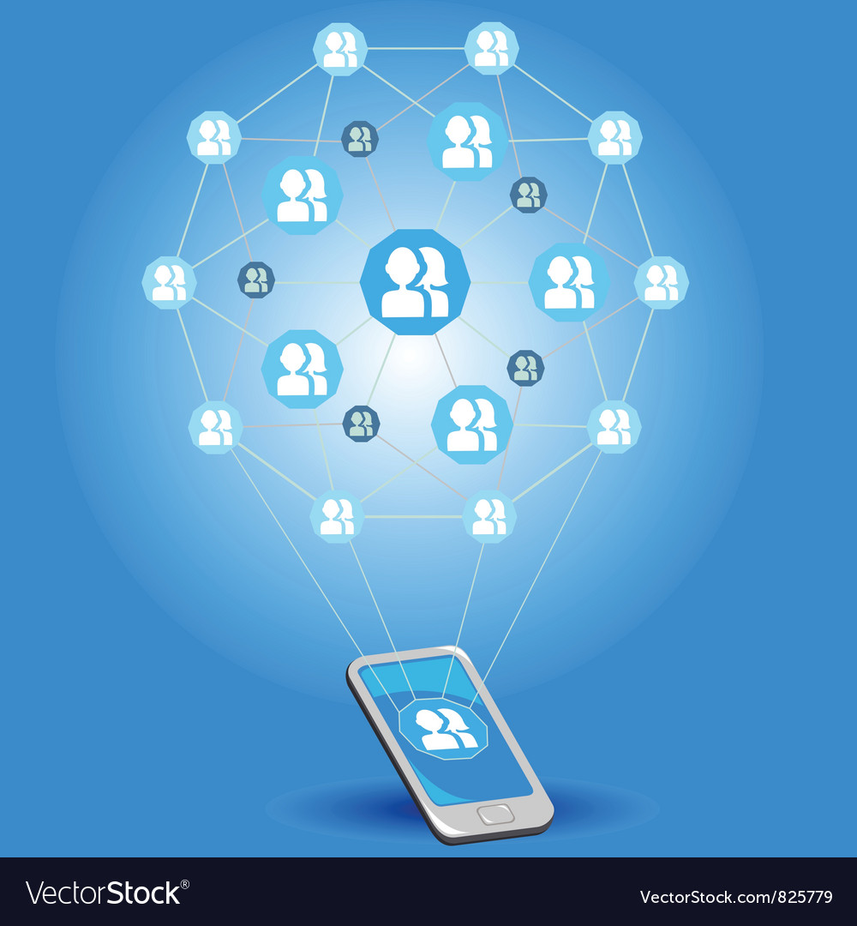
Social and Mobile
Social media platforms play a vital role in today’s age. Chatting, tweeting, commenting and liking other’s comments have become a routine feature. Social networking started from web based applications . With the advancement of technology it has moved to mobiles.

Slide 5
Mobile Social Network
A mobile social network is a social network where people with common interests meet and converse using a mobile phone or a tablet.
It is similar to Web-based social networks and also makes use of virtual communities, with the difference being in the device used. A virtual community is a social network of individuals who connect through specific social media, potentially crossing geographical and political boundaries in order to pursue mutual interests or goals. Some of the most pervasive virtual communities are online communities operating under social networking services
Mobile social networks make use of mobile messaging applications and are considered one of the best ways for providing a smoother user interaction and also for engaging users.
Many web-based social networking sites, such as Facebook and Twitter, have created mobile applications to give their users instant and real-time access from anywhere they have access to the Internet.

Slide 6
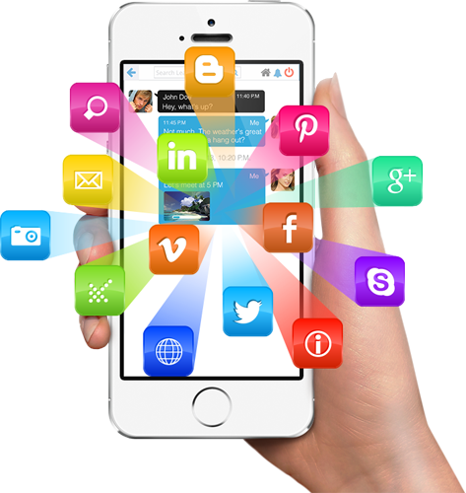
Mobile Apps for Social Networking
Social networking has gone mobile. With better operating systems and faster networks, we no longer have to wait until we get home to check our Facebook pages or our Twitter feeds. Now, everything can be done right from our smartphones.
And as our smartphones get smarter, so do the mobile apps that can connect us with our networks. Most important is that all of them are free.

Slide 7
Use of Apps and Models
Mobile social networking sites allow users to create a profile, send and receive messages via phone or computer and visit an online version of a mobile site.
There were different models which were adapted by different networking sites.
Most of these sites have many unique features or special functions, but the main function of the site remains the same as other services.
All these sites are categorized according to the business models and usage.

Slide 8
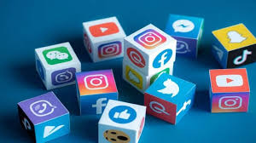
Types of Mobile Apps
Social network
There are just many social network on mobile devices like Facebook and Twitter
They offer vast number of functions including multimedia posts, photo sharing, and instant messaging.
Some mobile apps offer free international calling and texting capabilities.
Social networking apps are not just for the social aspect, but are frequently used for professional aspects as well, such as LinkedIn, which is still constantly growing
Along with sharing multimedia posts and instant messaging, social networks are commonly used to connect immigrants in a new country. social media can be used to connect immigrants of the same land together to make assimilation a little less stressful.

Slide 9

Types of Mobile Apps
Messaging
This model is focused on the ability to send short, text-based messages to an individual, group of close friends, or even a large group of classmates, simultaneously.
This category enables messages to reach the right people as quickly as possible.
Messaging apps are very popular, maybe even more than classical texting
Some social network platforms, such as Facebook, have their own native messaging applications, similar to Facebook Messenger.
Different countries have a certain messenger that is predominant, like China with WeChat, Korea with KakaoTalk, and the US with WhatsApp

Slide 10

Types of Mobile Apps
Media Share
It as an advanced version of the messenger category.
In addition to text messages, audio and video files can be transmitted among a group, such as Skype or Oovoo, which are forms of online video chatting.
In the case of Instagram and Vine, photos and videos of personal lives are shared to either friends or to the public
Pinterest is used to share photos, but on a more community level.
The largest media sharing app today is YouTube, which allows people post videos and share with the public.
Many of these services store media content online for easy storage and access

Slide 11
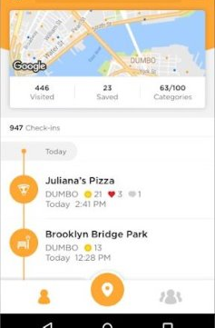
Types of Mobile Apps
Local Discoverability
Some mobile social networks, such as Yelp, FourSquare and YikYak, allow users to search for local venues.
Many of these apps publish crowd-sourced reviews and tips about restaurants, shops, places of interest and more.
Yelp and FourSquare also personalizes each user's database according to their latest search and interest to make searching more efficient.

Slide 12
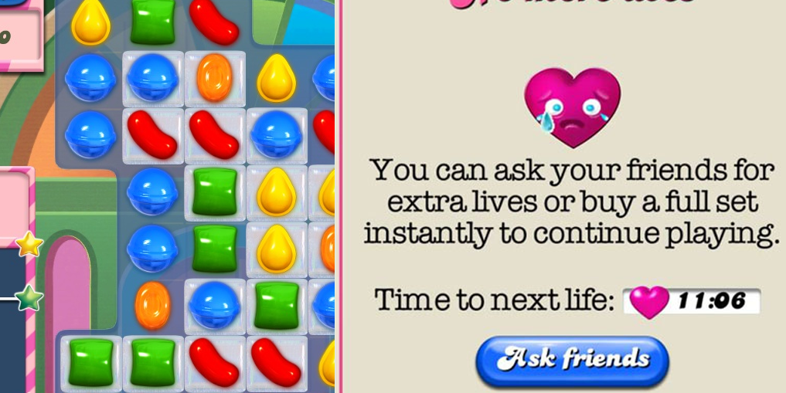
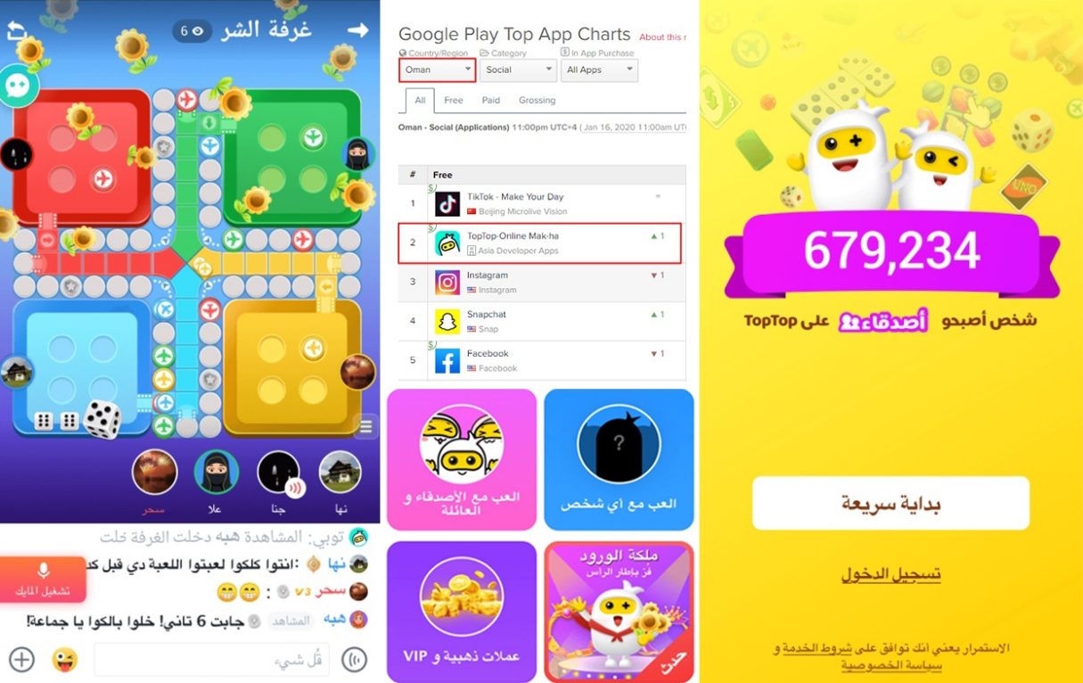
Types of Mobile Apps
Social Gaming
This model is about connecting people through both multi-player games and competitive single-player games
The leader in this category is Zynga, creators of Farmville and Words with Friends, though it has suffered a decline.
Hearthstone is another popular mobile game where players use monster and spell cards to fight each other.
In Naruto Blazing players can choose one person from a set of players to be on their team while fighting enemies throughout the game.
Mobile social networks can also connect people outside of the mobile environment. Pokemon Go incorporated augmented reality to allow players to catch Pokémon while together physically while outside.
Players can also battle each other at gyms in various locations in the world.
Facebook has also integrated games through its chat messenger. For example, friends can play chess by sending "@fbchess play" to the other person or basketball by sending a basketball emoji and clicking on the emoji.

Slide 13
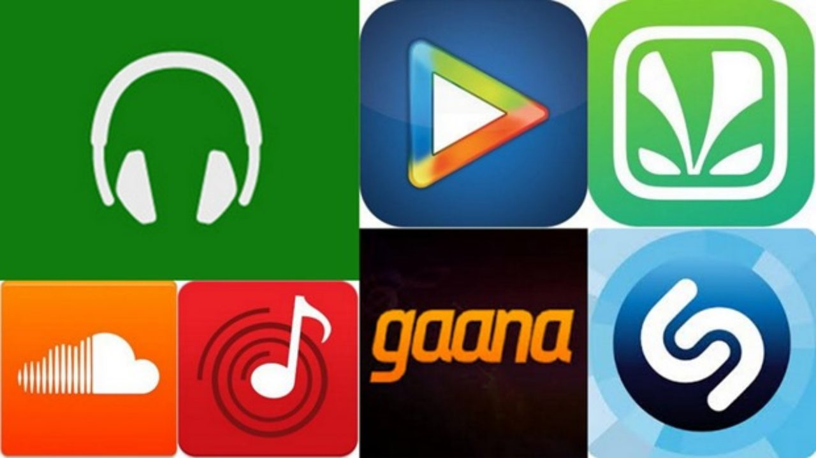
Types of Mobile Apps
Music Apps
Music apps connect people by sharing playlists and being able to see what other people are listening to.
Spotify, a very popular music site, is also used to social networking in a sense that people can see what their friends are listening to at the moment as well.
Users can also follow certain artists or even friends that they want to, which is a form of “liking” a post on Facebook.
Other social media music apps include radio stations like Pandora and last.fm.

Slide 14
Types of Mobile Apps
Mobile Commerce
Mobile commerce, or m-commerce, is a branch of e-commerce, that is available in a form of apps and mobile sites.
In some apps like letgo, it is easy for the buyer to talk to the seller about specifics about the product or negotiate the price and this assumes a form of social networking.
Some major e-commerce sites, such as Amazon and eBay, are also available in apps, so that people can shop anytime and anywhere.
Facebook Marketplace where people can sell and purchase products through their mobile devices.
Many e-commerce and m-commerce applications are also increasingly developed to interface with other applications such as mobile payment, banking, and ticketing applications so customers can easily pay or accept payments.
Similarly , one can find many other apps like fitness, dating, payment

Slide 15







Platforms Used By Apps
Facebook
iPhone, iPad, Android, BlackBerry, Windows Phone
Twitter
iPhone, iPad, Android, BlackBerry, Windows Phone
Skype
iPhone, iPad, Android, Windows Phone
Instagram
iPhone, iPad, Android
StumbleUpon
iPhone, iPad, Android
Yelp
iPhone, iPad, Android, BlackBerry, Windows Phone
Bump
iPhone, iPad, Android

Slide 16
Functions of a Social Media App
simple user interface;
easy search;
personalized user profile;
notifications and real time updates;
news feed;
messaging;
message status;
the ability to attach different files;
commenting and liking
the ability to upload content;
the ability to create groups and communities;
the ability to edit the user profile;
sharing capabilities connected to other social channels;
emojis and stickers;
the ability to send invites;
the ability to add or remove friends/connections

Slide 17
Advantages
Mobile messaging apps are one of the best ways to provide engagement and smooth user interaction
There is no need to use lengthy words while messaging; instead users can make use of voice messages, abbreviated words, smileys, stickers for healthy conversation.
Mobile messaging apps allows the users to share videos and images with their friends, family or all other people.
Mobile messaging apps are the way to save extra cost spent on messaging. What one requires is just internet pack on Smartphone to deliver messages.
Mobile messaging apps have the feature of mailing the entire conversation, and therefore, users can also save it and read it a later stage.
The best part of mobile messaging apps is group messaging. The groups can be formed and an open conversation can be there between all the members.
Mobile messaging apps are useful for various business purposes also. They help in sending the pictures of the products to customers and get new orders.

Slide 18
Disadvantages
Whether it is in traditional form of messaging or messaging apps, users like to use abbreviated language that adversely affects their writing skills.
Mobile messaging apps are addictive and people are getting used to it. It is becoming an addiction like the other drugs.
Mobile messaging apps use is rising day by day and people are living in a factual word surrounded with factual relationships.
There are numerous mobile messaging apps available for download, and even users download them and spend their entire time in checking the messages again and again.
Mobile messaging apps are even a problem to Smartphones too. Although the Smartphone have the storage, but then too downloading too many messaging apps makes it work slow.

Slide 19
Challenges in Mobile and Social Networking
Safety issues (including security, privacy, and trust) in mobile social networks are the main concerns in the development of social networking apps on mobiles
A protection against different types of failure, damage, error, accidents, harm or any other non-desirable event can occur while mobile carriers contact each other in mobile environments.
Lack of a protective infrastructure in these networks has turned them in to convenient targets for various perils.
The evolution of mobile devices has also introduced new offline, or physical, safety concerns. The distractions caused by mobile social networks have cause numerous accidents due to the user not paying attention to their surroundings.
Mobile messaging apps have both advantages and disadvantages. Messaging is one of the finest way to exchange information and communicate in a device-agnostic worldwide way. It can be used for both the commercial and personal use. However, excess of anything is bad. The same thing applies for mobile messaging apps. They are for convenience but people are making it addiction leading to health and psychological problems.

